Slide 1
Slaviša Đurđić
Apple Stock Data
Goal: Analysis of the 3-year Apple stock data with Python and Looker Studio.
Instructions:
- With the use of ChatGPT collect data by downloading Apple stock data for period 1/1/2020-1/1/2023 from Yahoo Finance via yfinance python library.
- Load the data to MySQL and CSV file.
- Execute SQL queries in MySQL to calculate daily returns of Apple stock for 1/1/2020-1/1/2023 period as well as the mean and standard deviation.
- Connect to the CSV file from Looker Studio and build visuals (https://lookerstudio.google.com/reporting/650846d0-8a6c-473a-95ea-f73398897ce1/page/Co9hD).
- With the use of ChatGPT perform many different quantitative models in Python such as Descriptive statistics, Time Series (ARIMA), Volatility Model (GARCH), Exponential Moving Average (EWMA), Regression Analysis, Correlation Analysis, Machine Learning Models - Linear Regression and SVM, Black-Scholes Model, and Monte Carlo Simulation.
Belgrade, November 2023

Slide 2
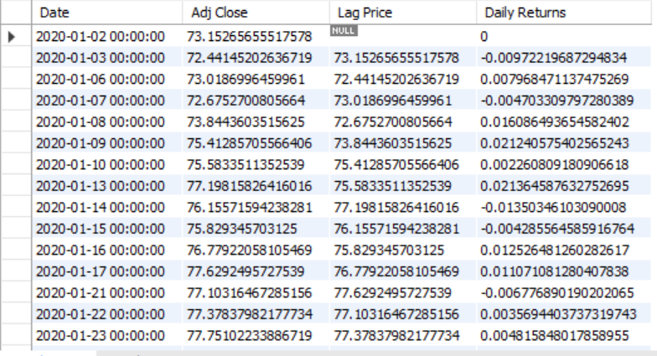

MySQL queries
Daily Returns:
WITH CTE AS (SELECT Date, `Adj Close`, LAG(`Adj Close`) OVER (ORDER BY Date) AS `Lag Price` FROM data_analysis.appl_stock_data)
SELECT *, COALESCE((`Adj Close` - `Lag Price`)/`Lag Price`,0) AS `Daily Returns` FROM CTE;
Mean and Std_Dev:
WITH CTE AS (SELECT Date, `Adj Close`, LAG(`Adj Close`) OVER (ORDER BY Date) AS `Lag Price` FROM data_analysis.appl_stock_data)
SELECT AVG((`Adj Close` - `Lag Price`)/`Lag Price`) AS Mean, STDDEV((`Adj Close` - `Lag Price`)/`Lag Price`) AS `Standard Deviation` FROM CTE;

Slide 3

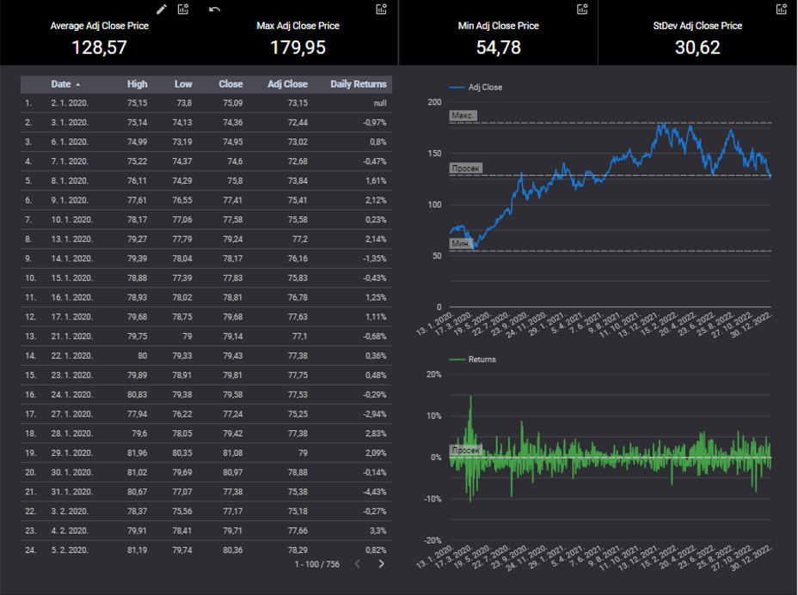

Slide 4
Python: Descriptive Statistics
Mean: 0.0010238516697724193
Median: 0.000612836751005208
Standard Deviation: 0.023250408955269503
Skewness: 0.09503702520756134
Mean: 0.0010: The average daily return is slightly positive.
Median: 0.0006: The median return is lower than the mean, suggesting a right-skewed distribution.
Standard Deviation: 0.0233: The volatility of the returns is moderate.
Skewness: 0.0950: The skewness is positive, indicating a right-skewed distribution.

Slide 5
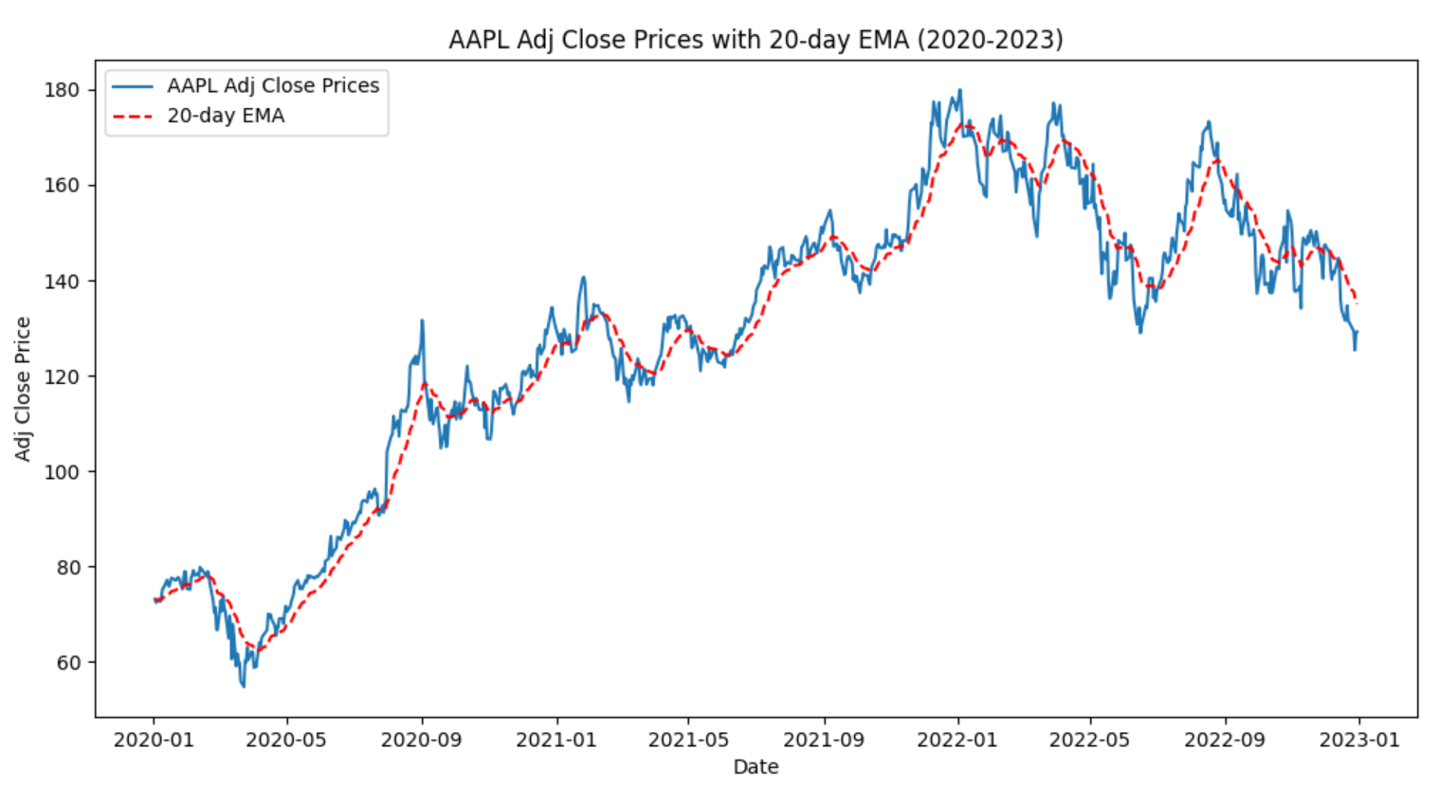
Python: Exponential Moving Average (EWMA)

Slide 6
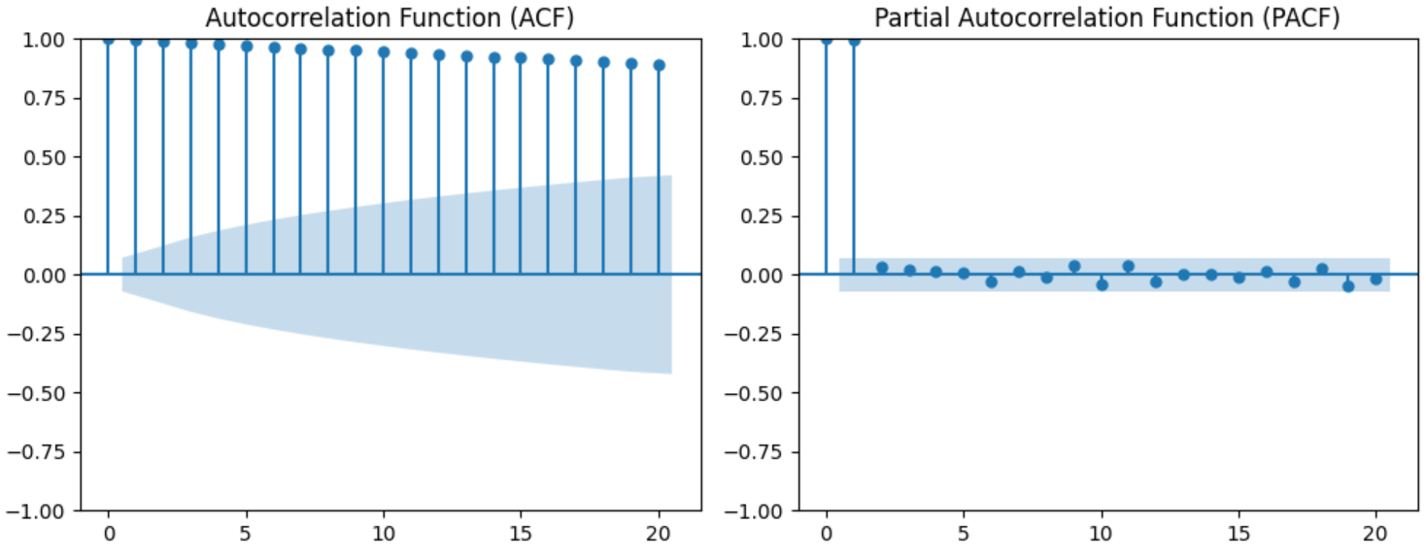
Python: ACF and PACF

Slide 7
Python: ARIMA Model
ADF Statistic: -8.814456147513525
p-value: 1.951322546736139e-14
ADF Statistic (Differenced): -12.186960184573932
p-value (Differenced): 1.3120355222629584e-22
ADF Statistic: -8.8145: The ADF statistic is highly negative, suggesting stationarity.
p-value: 1.95e-14: The p-value is very low, providing strong evidence against the null hypothesis of non-stationarity.
The highly negative ADF statistic and low p-value indicate that the time series is likely stationary. Differencing is used to achieve stationarity.
ADF Statistic (Differenced): -12.1870: The ADF statistic for differenced series is also highly (even more) negative.
p-value (Differenced): 1.31e-22: The p-value for differenced series is very low, confirming stationarity.

Slide 8
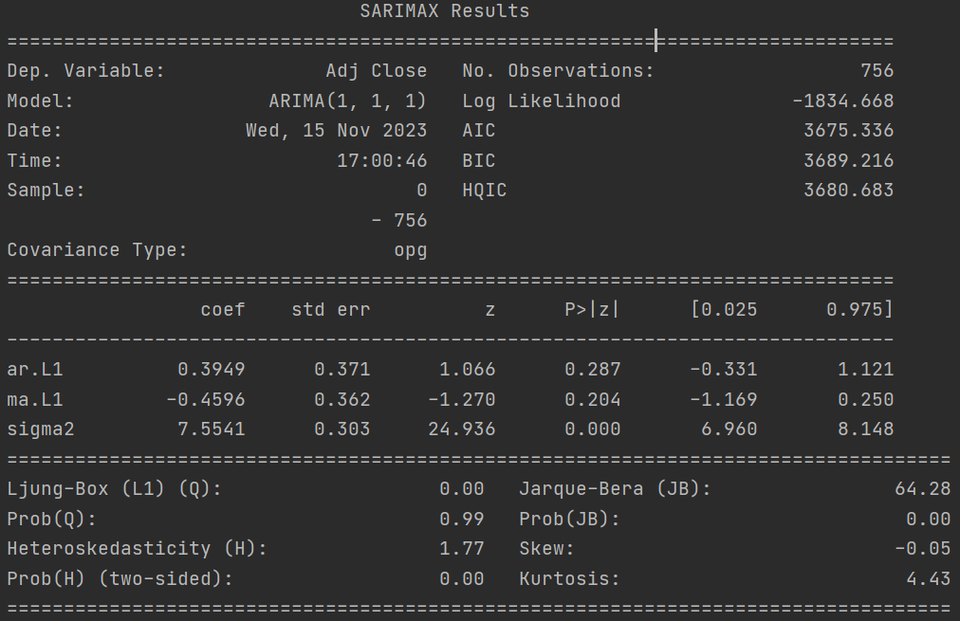
Python: ARIMA Model (2)
ARIMA original result summary:
The ARIMA(1, 1, 1) model is fitted with estimated coefficients.
The p-values for ar.L1 and ma.L1 indicate that these coefficients are not significantly different from zero.
The Ljung-Box (Q) and Jarque-Bera (JB) statistics are used for model diagnostics.

Slide 9
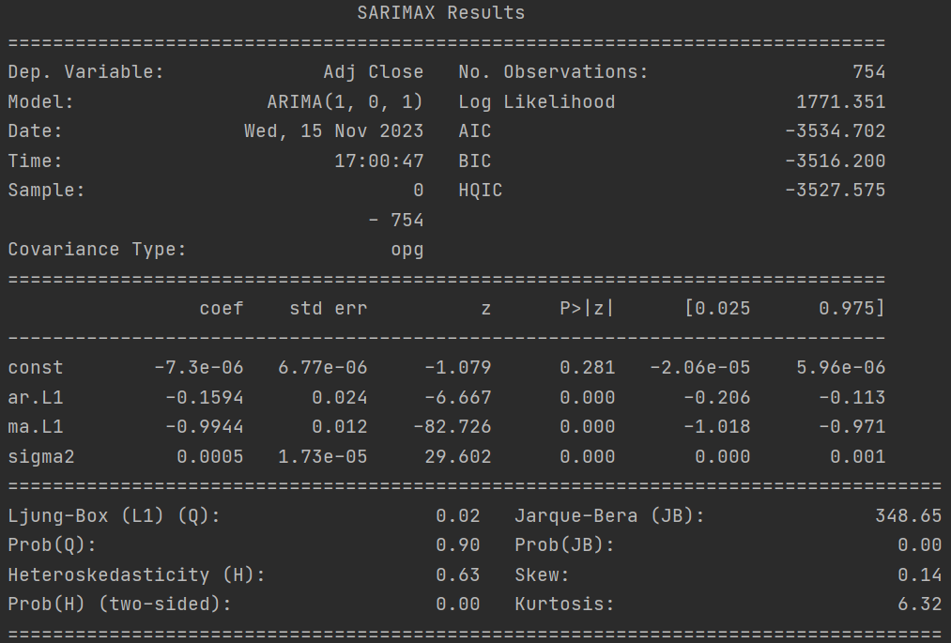
Python: ARIMA Model (3)
ARIMA differenced result summary:
The ARIMA(1, 0, 1) model on differenced series is fitted.
The const term is insignificant, but ar.L1 and ma.L1 are significant.
The model diagnostics include Ljung-Box, Jarque-Bera, and information criteria.

Slide 10
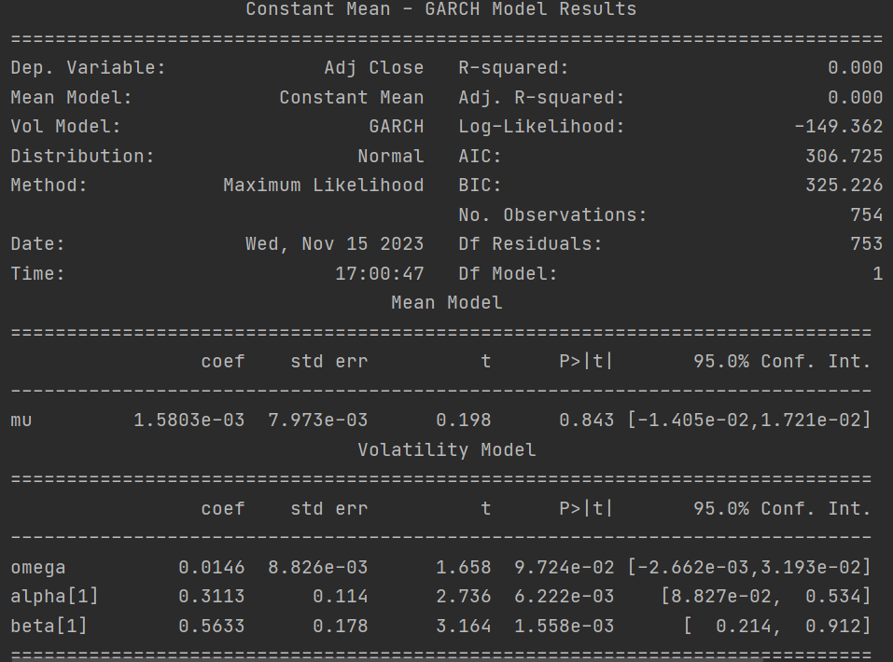
Python: GARCH Volatility Model
Constant Mean-GARCH(1,1) model is fitted with estimated coefficients.
The omega, alpha, and beta parameters represent the constant, ARCH, and GARCH terms, respectively.
The model suggests low volatility.

Slide 11
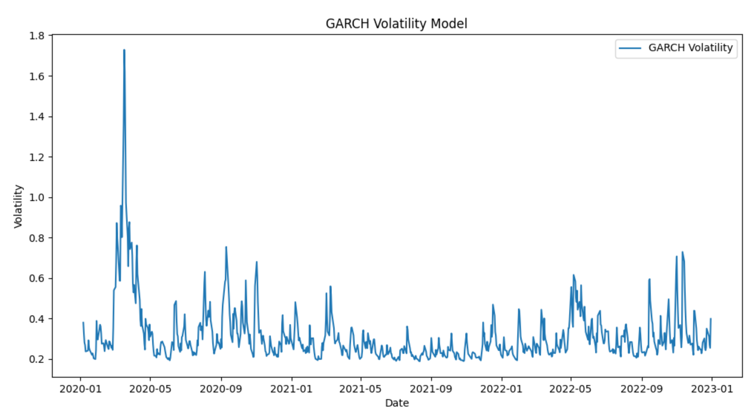
Python: GARCH Volatility Model (2)

Slide 12
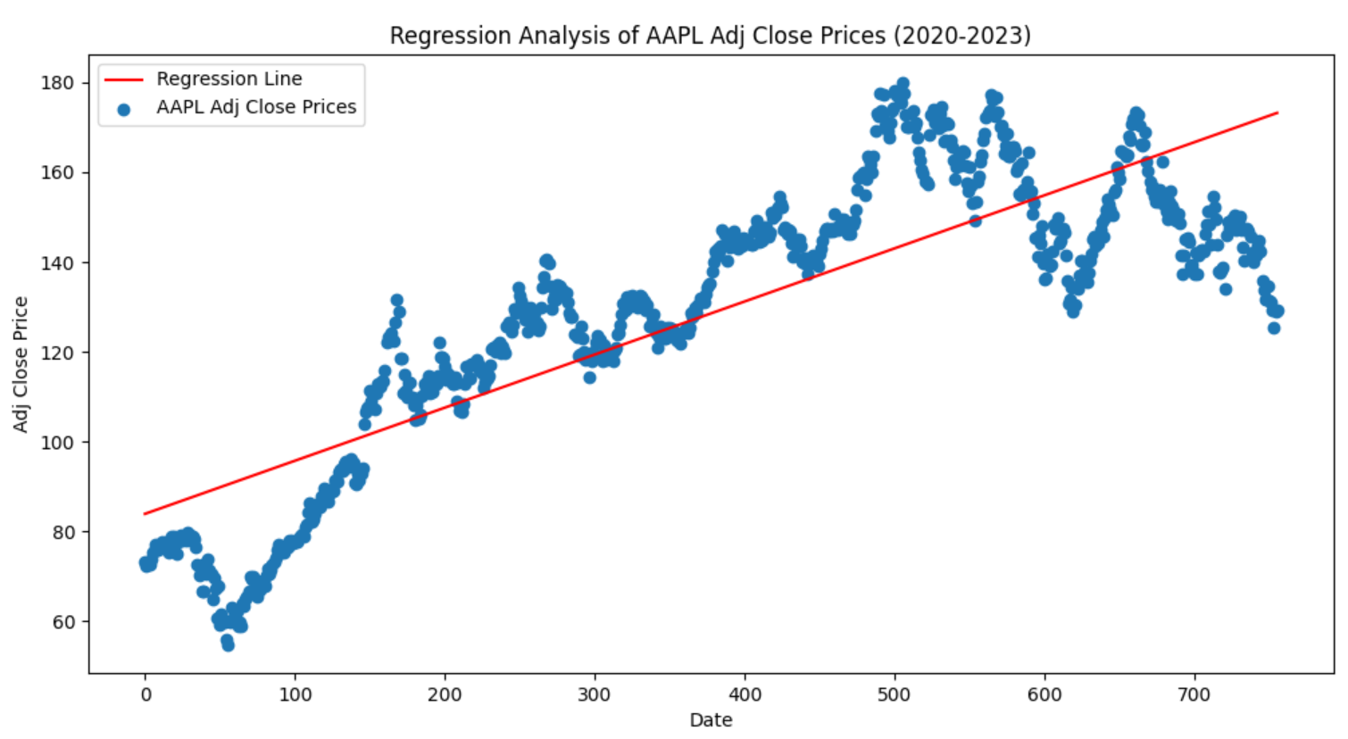
Python: Regression Analysis

Slide 13
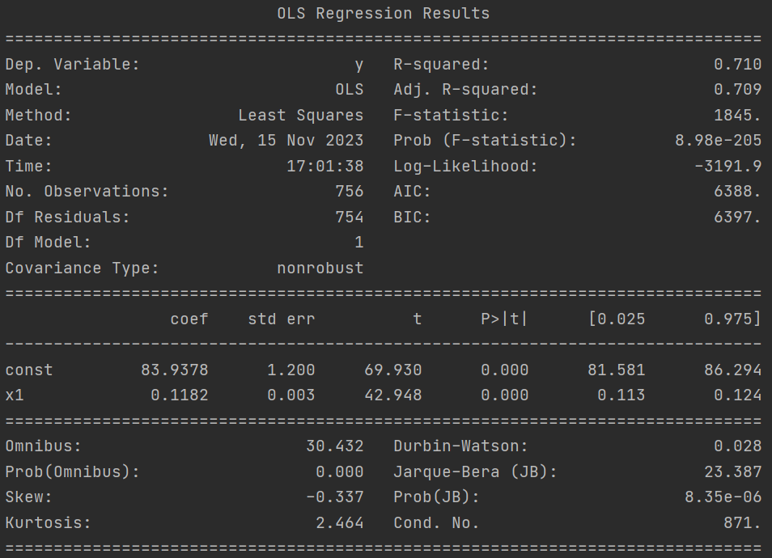
Python: Regression Analysis (2)
Linear regression is performed on the time series against time.
The regression equation is Adj Close = 83.9378 + 0.1182 * Time.
The R-squared value indicates that the model explains about 71% of the variance.

Slide 14
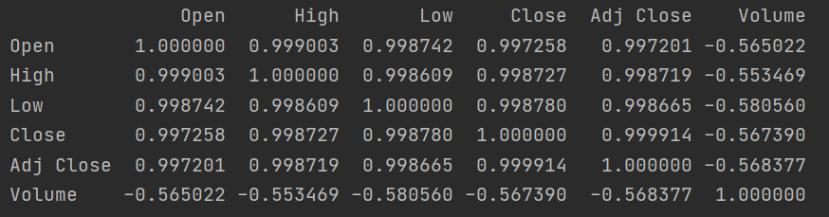
Python: Correlation Analysis
The correlation matrix shows the correlation between different columns in the stock data.
Strong positive correlations are observed between Open, High, Low, Close, and Adj Close.

Slide 15
Python: Machine Learning Models
Linear Regression Mean Squared Error: 290.4730999700918
SVM Mean Squared Error: 115.60361283279501
Linear Regression Mean Absolute Error: 13.957960870600573
SVM Mean Absolute Error: 8.749303776097939
These metrics give an indication of model performance; lower values are better, and these metrics give an indication of how well the models fit the data.

Slide 16
Python: Black-Scholes Model
# Parameters for Black-Scholes
spot_price = time_series.iloc[-1] # current stock price
strike_price = spot_price * 1.1 # arbitrary strike price
time_to_maturity = 1 # arbitrary time to maturity in years
risk_free_rate = 0.01 # arbitrary risk-free rate
volatility_bs = results_garch.conditional_volatility[-1] # using GARCH volatility as a proxy for future volatility
# Calculated parameters
Spot price is 129.20777893066406. Strike price is 142.1285568237305. TTM is 1. Risk-free rate is 0.01. Volatility is 0.3987778042564108.
Black-Scholes Call Option Price: 16.06

Slide 17
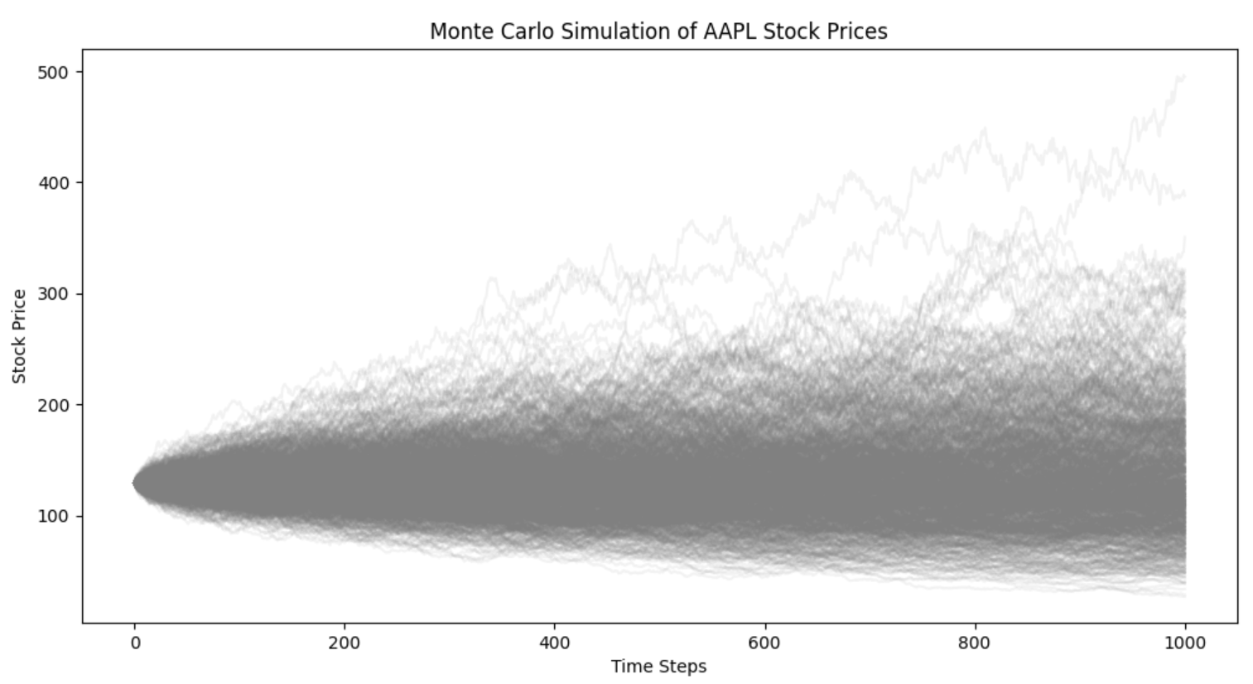
Python: Monte Carlo Simulation
# Number of simulations = 1000.

